Slide 1


Slide 2


Slide 3
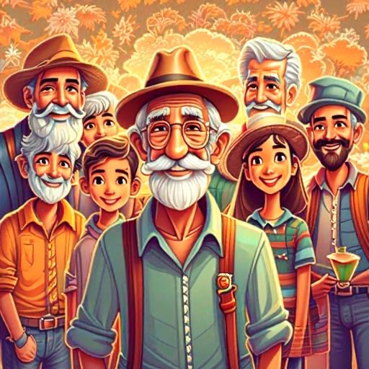
THE SONS OF RECHABITES
Chapter 1
1

Slide 4
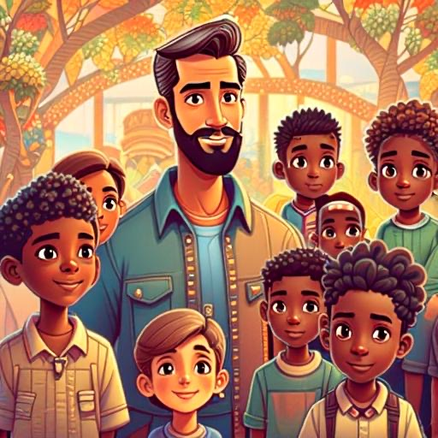
Once upon a time, there was a group of special people called the Rechabites. They were a family that followed some important rules set by their wise grandfather, Jonadab. These rules helped them live a good and happy life.
Now, the Rechabites had a simple rule: they didn't drink wine. This rule was part of the promise their grandfather made to God a long time ago. The Rechabites were faithful to that promise, so they stayed away from drinking wine.
2

Slide 5
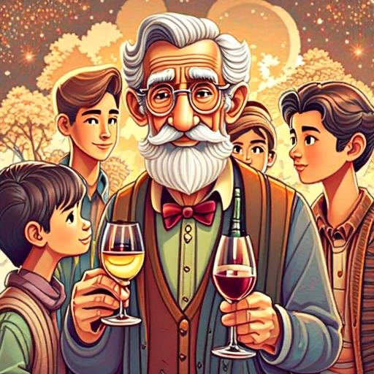
One day, a man named Jeremiah, who was a friend of God, came to visit the Rechabites, He wanted to test if they would keep following their special rule even when things got tough.
Jeremiah invited the Rechabites to a party and offered them cups of delicious, tempting wine. But guess what? The Rechabites remembered their promise to their grandfather and to God. They politely said, "No, thank you, our father told us not to drink wine," and they didn't drink the wine.
3

Slide 6
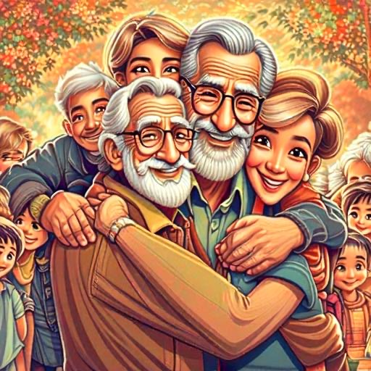
Jeremiah was impressed! He knew that the Rechabites were obedient to their family rules. He told them that God was happy with them because they listened and obeyed.
Just like the Rechabites, we can make our families proud by doing what's right, even when it's not easy. So, the next time you face a choice between doing something you know is right or something that might not be so good, remember the Rechabites and choose the path that makes God happy. And just like them, you'll be creating a legacy of goodness and faithfulness for the future!.
4

Slide 7
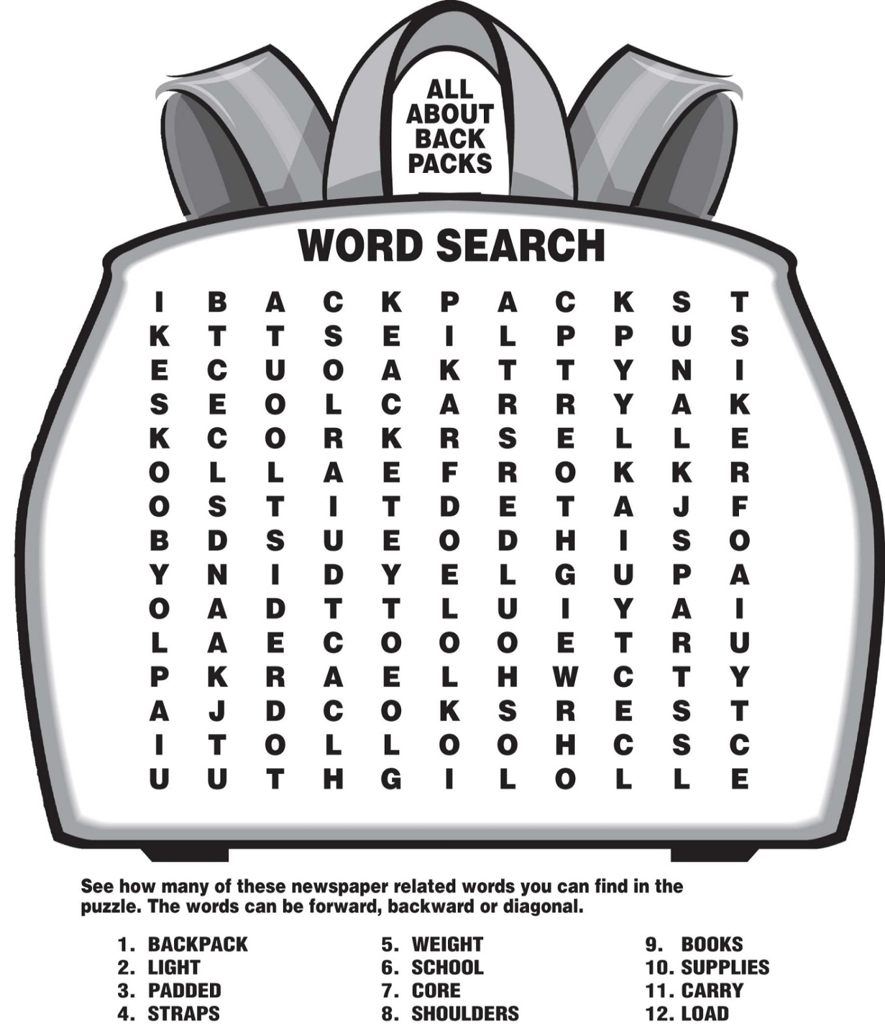
Class Activities
Read: Jeremiah 35: 1-19, Ephesians 6:1-4
The word “RECHABITES” was used to form the alphabet “W” can you find it out ?
W
B | H | S | G | D | F | C | Z | S | Z | Z | Z | A | S | D | N | H | F | K | N
S | J | F | B | V | I | G | B | D | S | I | Q | F | S | X | Z | I | L | S | N
E | J | G | N | V | S | G | G | V | R | F | H | T | S | Z | Q | B | G | E | V
T | F | B | R | B | E | F | Q | E | E | E | T | T | S | D | G | H | M | T | X
I | T | B | J | F | R | J | C | U | I | O | C | P | S | Z | X | V | B | I | Q
B | G | F | M | H | U | H | B | R | I | H | N | H | B | X | Q | W | M | B | S
A | F | J | M | N | A | N | A | Q | Z | N | J | K | A | T | S | A | Z | A | E
H | J | H | G | B | B | F | G | B | W | G | D | T | I | B | F | T | F | H | E
C | K | T | I | J | I | O | I | Z | X | T | J | K | G | I | I | D | G | C | G
E | E | T | C | E | S | D | F | H | N | F | I | Y | R | F | V | T | B | E | Y
R | E | J | F | N | J | K | L | O | N | E | E | E | R | Y | I | D | E | R | I
S | H | G | S | D | V | F | F | K | P | D | B | S | X | N | I | E | S | S | K
5

Slide 8
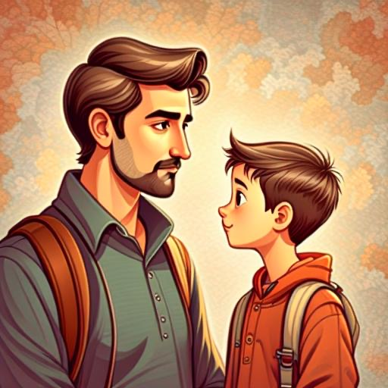
Chapter 2
MY FATHER TOLD ME NOT TO LIE
6

Slide 9
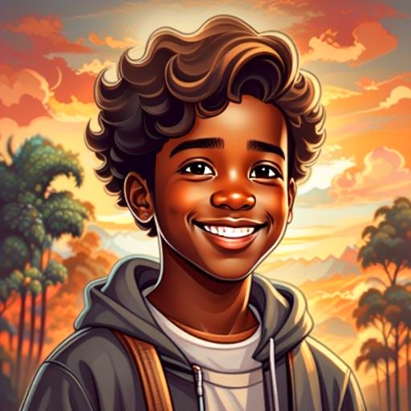
In a small village surrounded by rolling hills, there lived a little boy named Noah. Noah was known for his love of animals, colorful imagination, and his strong connection with God. His parents taught him the importance of honesty and always telling the truth.
7

Slide 10
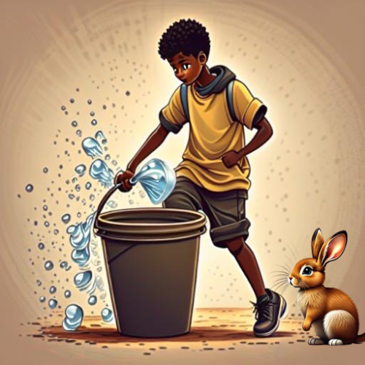
One sunny day, Noah's parents asked him to look after their garden. They reminded him to water the flowers, feed the chickens, and be truthful about anything that happened.
Noah happily set to work, singing joyful tunes as he tended to the garden. As he watered the flowers, he noticed a mischievous bunny nibbling on the leaves. In his excitement, Noah accidentally knocked over a pail of water.
8

Slide 11
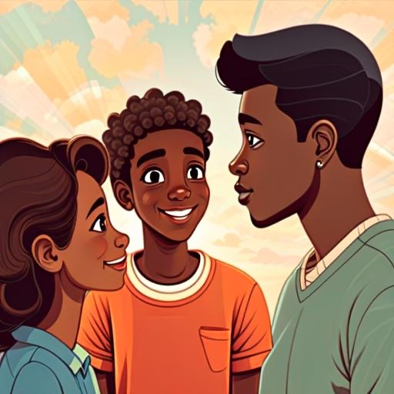
Feeling a bit worried, Noah considered hiding the little mishap from his parents. However, he remembered the stories they shared about God's love and the importance of being truthful.
Taking a deep breath, Noah ran to his parents and shared the entire story of the playful bunny and the spilled water. His parents smiled at him and praised him for his honesty.
9

Slide 12
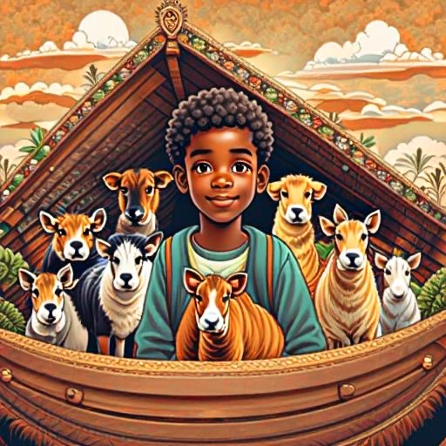
To reward Noah's truthfulness, his parents gifted him a small wooden ark. It was no ordinary ark; it had a special compartment inside. Noah's parents explained that whenever he told the truth, he could place a colorful, tiny animal inside the ark.
Noah loved the idea! From that day forward, whenever he faced a situation where he could choose to tell the truth or keep a secret, Noah always chose honesty. Each time he did, a new animal found its place inside his special ark.
10

Slide 13
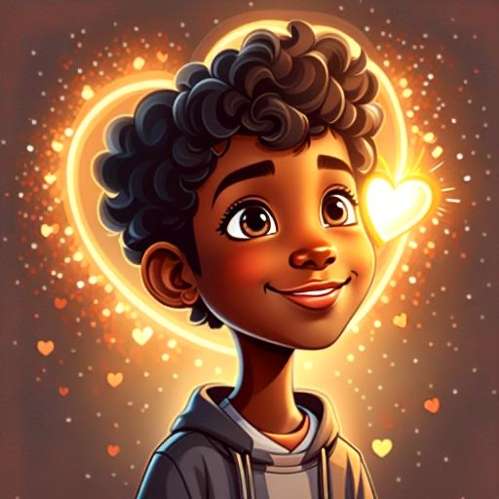
And so, the lesson was learned in the small village: Just like Noah's ark, honesty builds a special place in our hearts where God's love can always shine through. Little Noah's ark of truth became a symbol of the wonderful gift of honesty that he carried with him throughout his life.
11

Slide 14

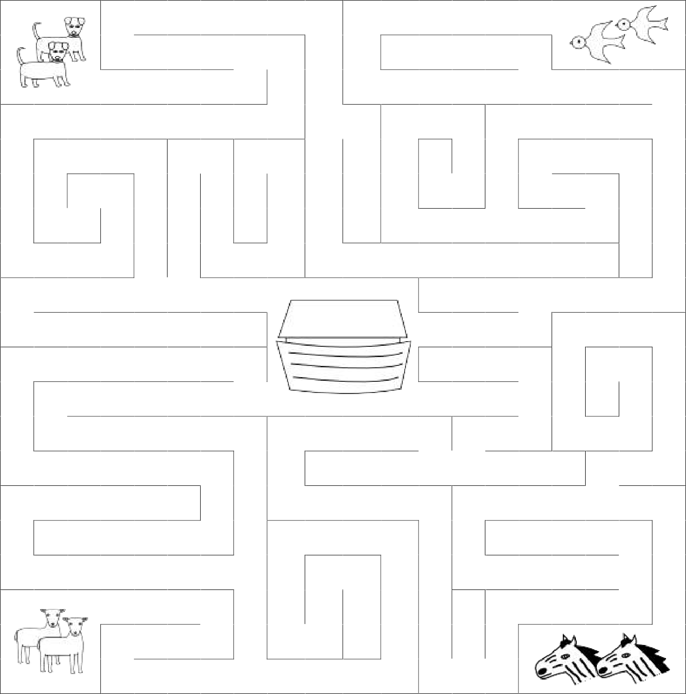

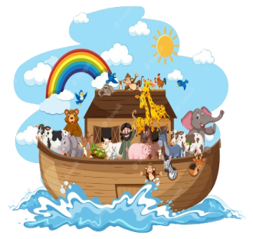
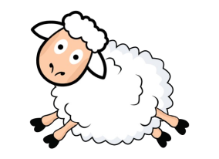
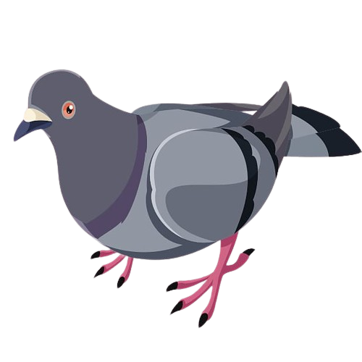
Class Activities Read: Gen 6: 9-22, Acts chapter 5:1-11, Lev 19:11,Proverbs 19:9, Proverbs 12:22 Could you help each animal find their way into the ark?
12

Slide 15
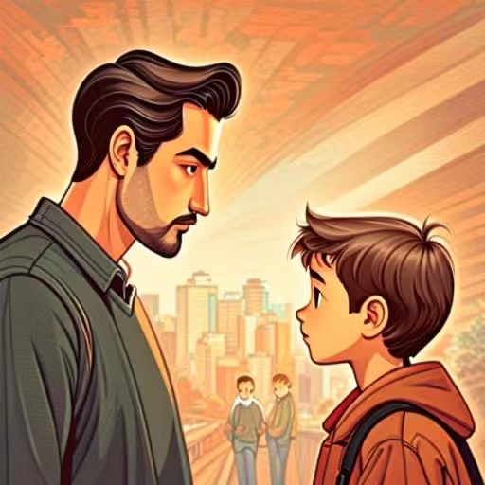
Chapter 3
My Father told me not to steal
13

Slide 16
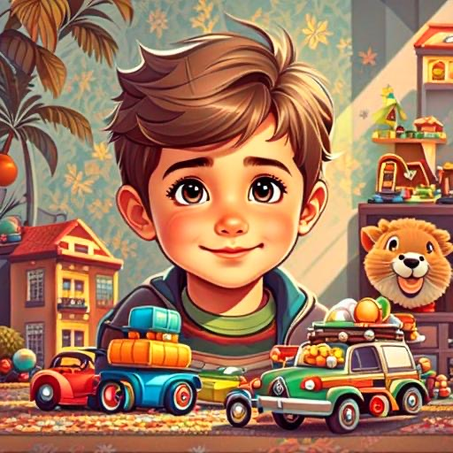
Once upon a time, in a small City, there lived a little boy named Timmy. Timmy’s Father always told him not to take anything that doesn’t belong or wasn’t given to him as that would be stealing. Timmy had a friend called Benny. Benny had many beautiful toys and always plays with them after school.
14

Slide 17
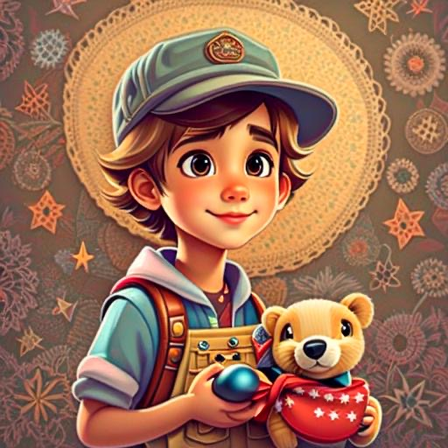
One day, when Benny was busy writing his homework, Timmy saw the toys and really wanted to play with them. Instead of asking Benny if he could borrow it, Timmy thought, "I'll just take it”
Timmy took the toys and played with it happily.
15

Slide 18
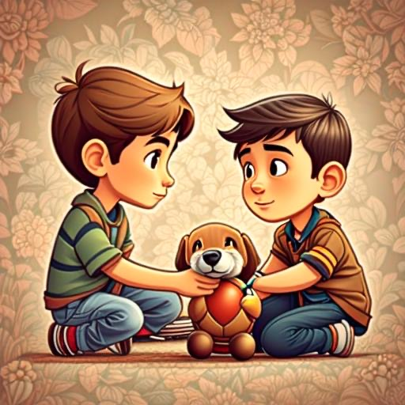
Later, when Benny realized his toy was missing, he asked Timmy if he had seen it. Timmy's heart raced, and he felt guilty. He knew he should have asked Benny first.
Taking a deep breath, Timmy said sorry to Benny and explained what happened. Benny, being a good friend, forgave Timmy, but he reminded him, "Next time, "Don't steal, just ask!", okay?"
16

Slide 19
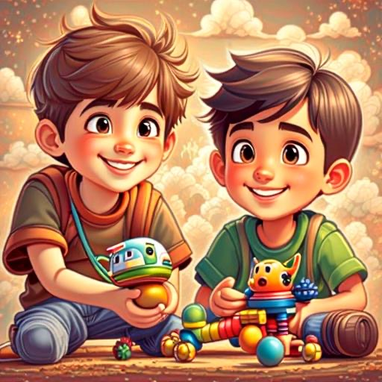
From that day on, Timmy learned an important lesson – it's always better to ask before taking something that belongs to someone else. Timmy and Benny enjoyed playing together, making sure to share and ask nicely. They both lived happily, respecting each other's toys and having lots of playful adventures.
17

Slide 20
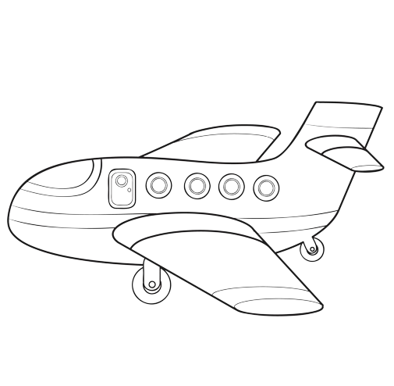
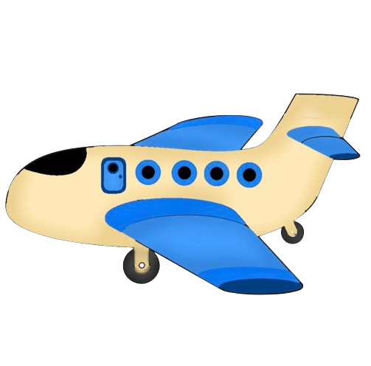
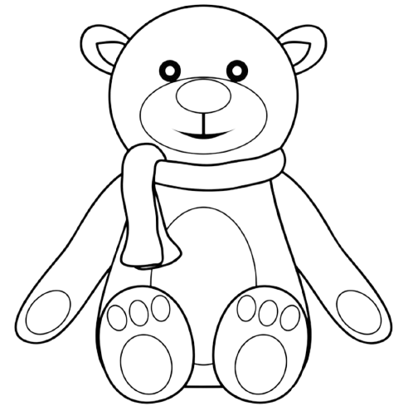
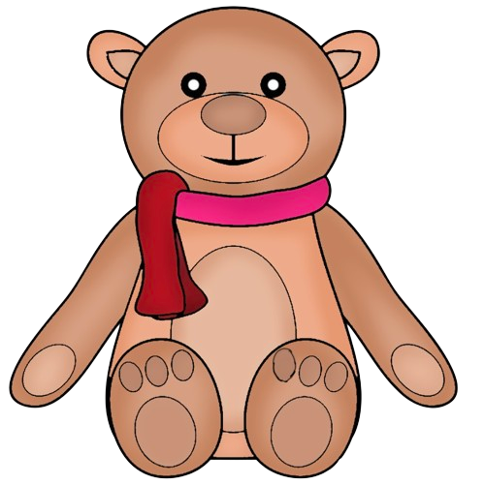
Class Activities Read: Exodus 20:15, Joshua 7:16-26 Color the images to match the image next to it
18

Slide 21
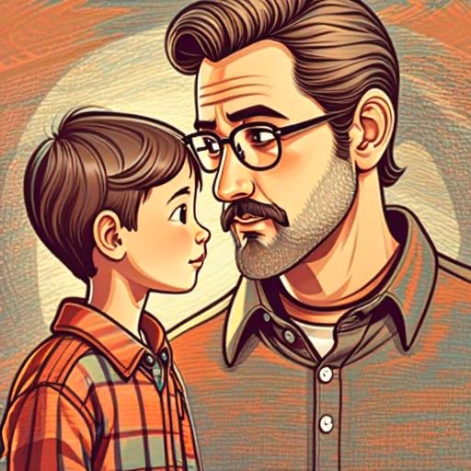
Chapter 4
My Father told me not to bully others
19

Slide 22
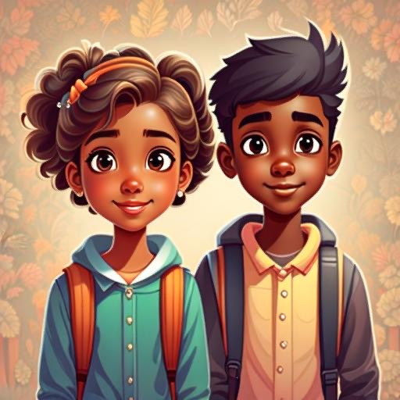
Once upon a time, in a sunny school, there was a little girl named Lily. Lily loved going to class and making new friends. But one day, she noticed a boy named Max sitting all alone during lunch time.
Lily went over to Max and asked, "Would you like to sit with me and my friends?"
Max smiled, feeling happy to have a friend like Lily. They all enjoyed lunch together, and Lily introduced Max to her favorite games.
20

Slide 23
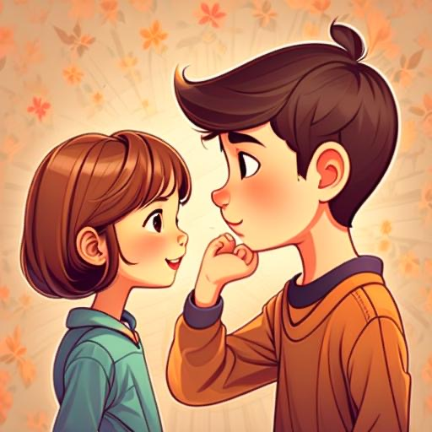
But, there was a tricky troublemaker in Lily's class named Sammy. Sammy liked to make fun of others, bullies them, makes them feel small and says unkind things about them.
21

Slide 24
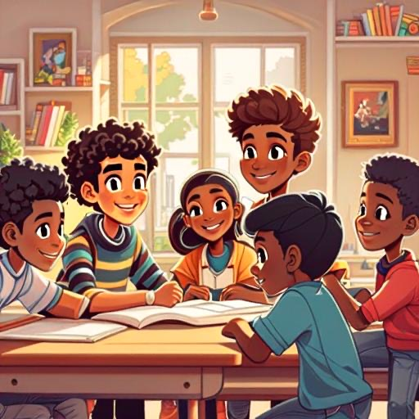
One day, Sammy was bullying Lily, making Max feel upset. Although Max was older and stronger than Sammy and would definitely beat him up in a fight. Instead of getting mad, Max had a smart idea. He gathered his friends and turned their desks into a Friendly Garden, a special place where everyone could be themselves without any trouble.
When Sammy saw the Friendly Garden, he realized how much fun it was to be kind and play together peacefully. Max explained, "In our class, we don't bully others or say mean things. We're a team of friends!"
22

Slide 25
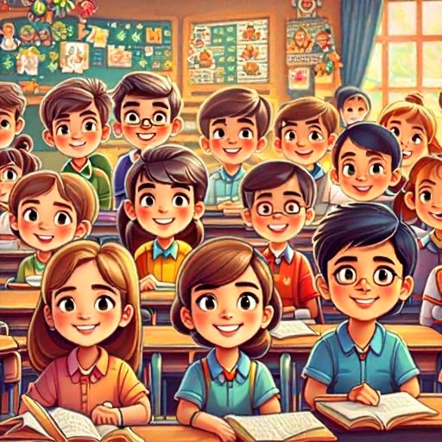
Sammy decided to join the Friendly Garden, and soon, he became friends with Max too. Lily's class became a happy place where everyone felt safe and cared for.
Max told Sammy and all his friends, “My father told me, “Don’t bully others, choose kindness, not cruelty!” The lesson Sammy and his friends learned was simple: in their class, they didn't let anyone be mean. So, in Lily's class, they all lived happily, learning, playing, and caring for each other.
23

Slide 26

Class Activities Read: Matthew 7:12, John 13:34-35, 1John 4:11-12
Fill in the blanks with the right words to complete the sentences
1. Bullying is when someone is mean, hurts feelings, or tries to scare another person _____.
Intentionally b. accidentally c. playfully
2. If you see someone being treated badly, be a good _____ by telling a grown-up so they can help.
helper b. beater c. enemy
3. Cyber bullying is when people use computers or phones to _____. Always be kind and use devices the right way.
play games b. be silly c. hurt others
4. If someone bullies you, it's important to _____ so they can help.
Bully them back b. tell a friend, teacher or parent c. keep quiet
5. Being friendly and working together is called _____. Let's be good friends and make everyone feel happy and included.
a. teamwork b. lonely c. alone
24

Slide 28


